Slide 1
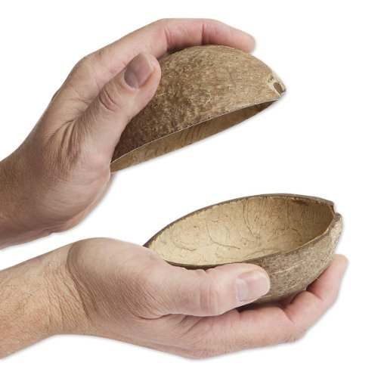
User Stories for Progression Tracking System
Coconut Team,
WILLIAM Wanger & MANAR Alkayed
27/9/2018
IST303

Slide 2
Main Stakeholder
Game Developer
GIT Repository : https://github.com/WillWagnerIV/The-Coconuts

Slide 3
Story 1:User Register
As a user I want to be able to sign in to be able to access and use the system.
Username
Password
Importance :20
Time required: 2 days

Slide 4
Story 2:User Login
Description Login screen for a registered user
Importance: 20
Time required: 2 days

Slide 5
Story 3:User Forgot Credentials
Description Offer to help the user retrieve their info
Email (?)
Test question (?)
Importance : 20
Time required: 2 days

Slide 6
STORY 4:Add Player
Description Form for developer to add a player’s information
First Name
Last Name
Games played
Email
Add fields
Importance : 10
Time required: 2 days

Slide 7
STORY 5:Add Game
Description: Form for developer to Add a Game
Game Name
In-Game Items
In-Game Rewards
In-Game Currency
Additional fields
Importance: 10
Time required: 2 days

Slide 8
Story 5:Add Character
Description: Form to add characters to a player
Importance :20
Time required: 2 days

Slide 9
Story 7:Modify Player
Description: Form for developer to modify a player’s information
First Name
Last Name
Games played
Email
Additional Fields
Importance :10
Time required: 2 days

Slide 10
Story 8:Player Report
Description: Screen for developer to request Player Report
Games played
Total Time played
Basic Info from Above
Importance 20
Time required: 3 days

Slide 11
Story 9:Game Report
Description: Screen for developer to request Game Report
Number of Players
Number of characters
Average Time of Player
Basic Info Above
Importance :20
Time required: 3 days

Slide 12
Story10:Items Report
Description: Sub Screen below Player or Game report for developer to request Items Report
Number of Items
Average Value of Items
Average Time of Player
Basic Info Above
Importance : 20
Time required: 3 days

Slide 13
Story 11:Progression Report
Description: Sub Screen below Player or Game report for developer to request
Progression Report
Number of Trophies
Number of Levels
Average Time to a given Trophy
Specific Trophy Stats
Basic Info Above
Importance: 20
Time required: 3 days

Slide 14
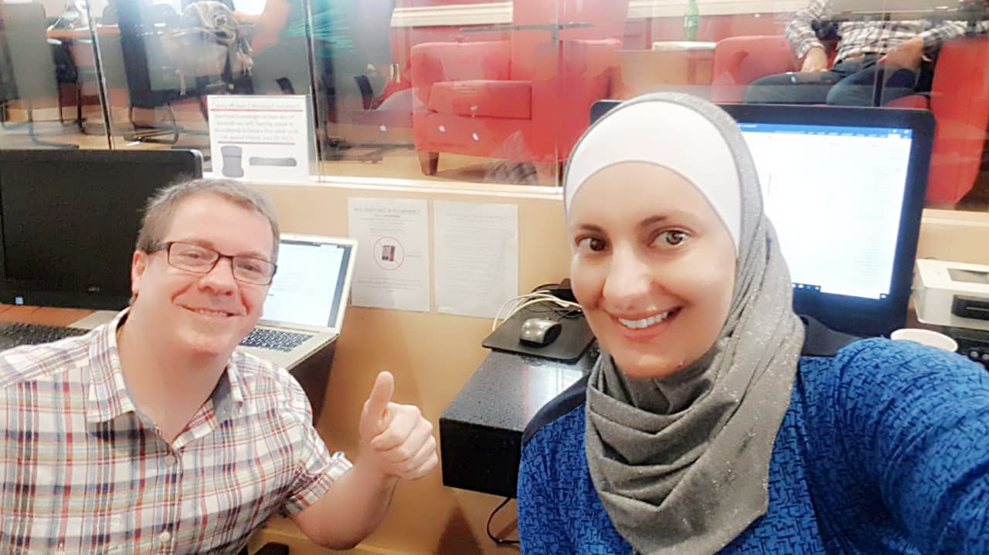
Thank you

